Slide 1
Court of Data on Gun Control-For
Xinyu Meng
xm73

Slide 2
What is Gun Control?
Gun control refers to laws and policies aimed at regulating the manufacture, sale, transfer, possession, modification, or use of firearms by individuals. The purpose of these laws is to reduce the number of gun-related deaths and injuries, whether by accident, suicide, or crime.
I will show in this presentation why we need more regulations for gun control to reduce more deaths and injuries.

Slide 3
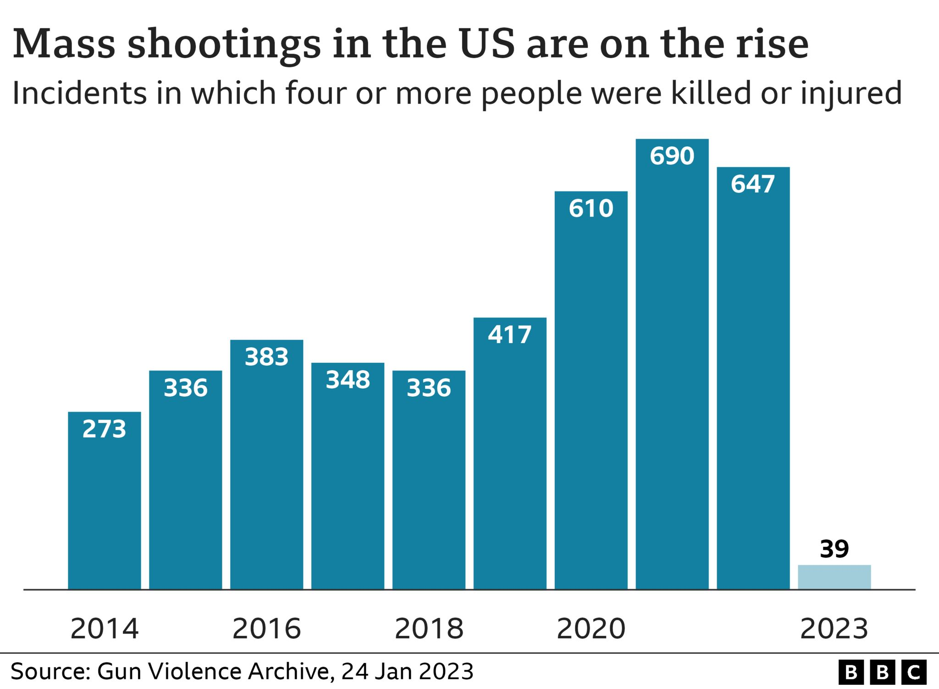
Mass gun shootings on the rise
Shootings are rampant in the United States.

Slide 4
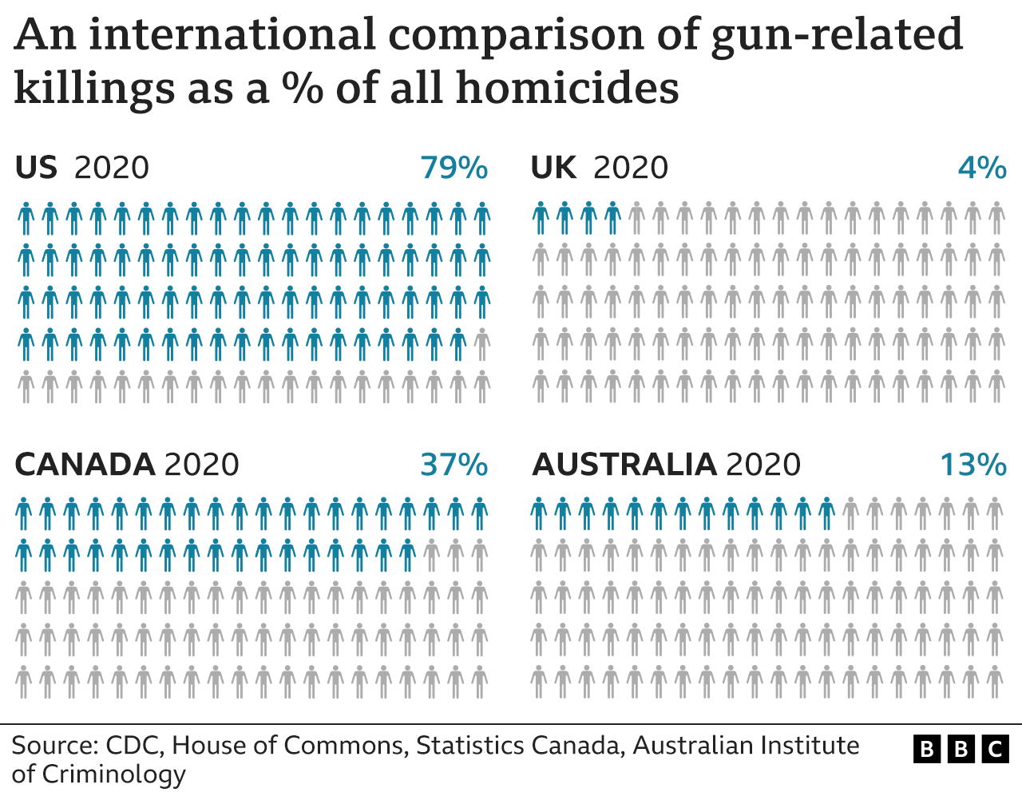
Gunshot injuries in the United States are a worldwide problem

Slide 5
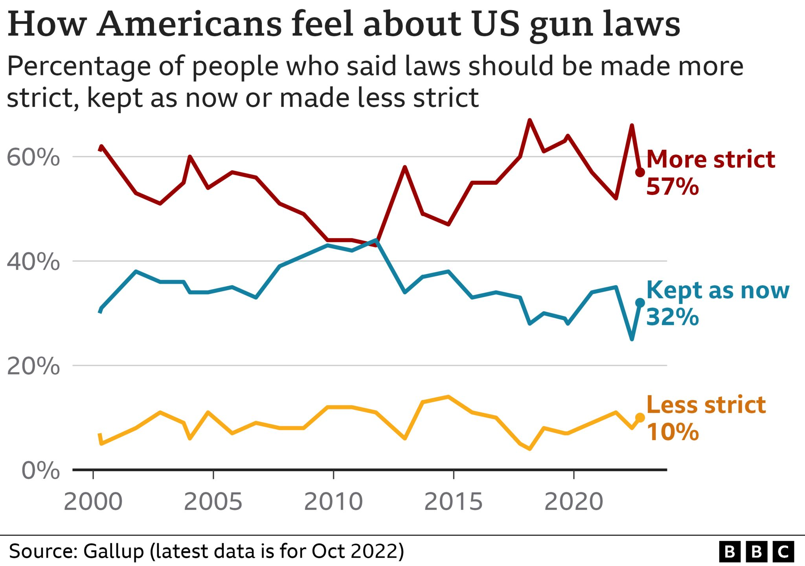
How Americans think?
It is clear that most Americans believe that the United States needs stricter gun control policies.

Slide 6
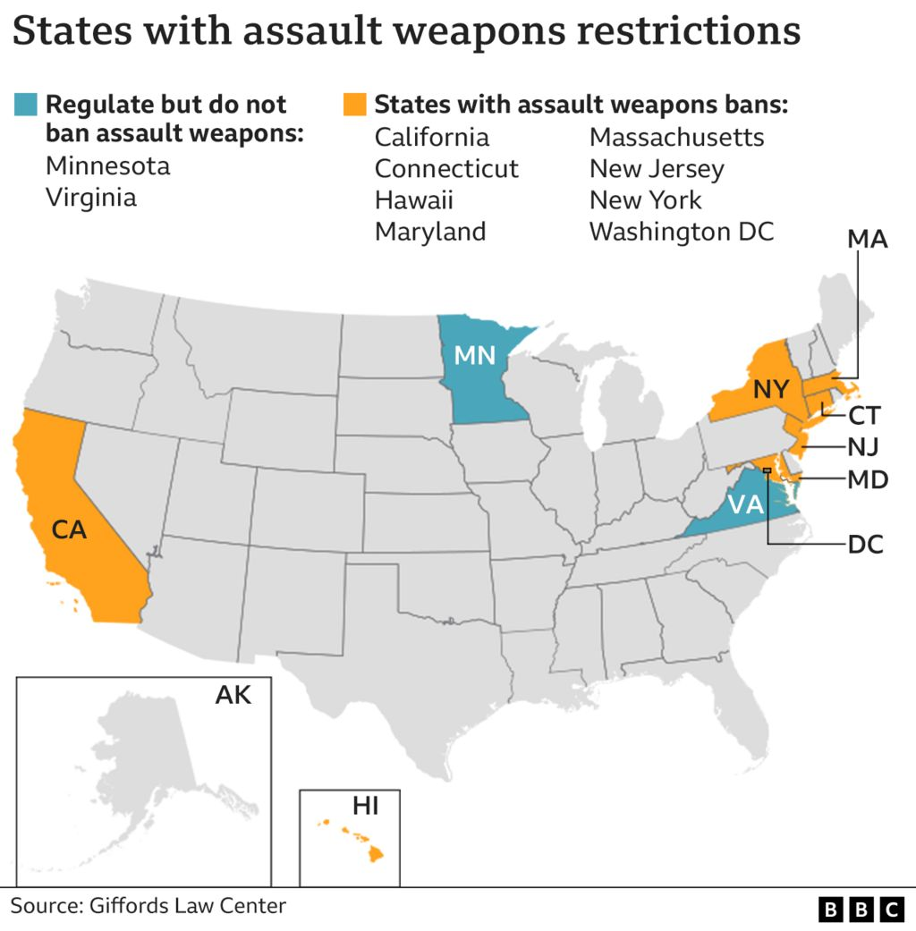
Some states in US has regulation for guns
Gun restrictions by state in 2022

Slide 7
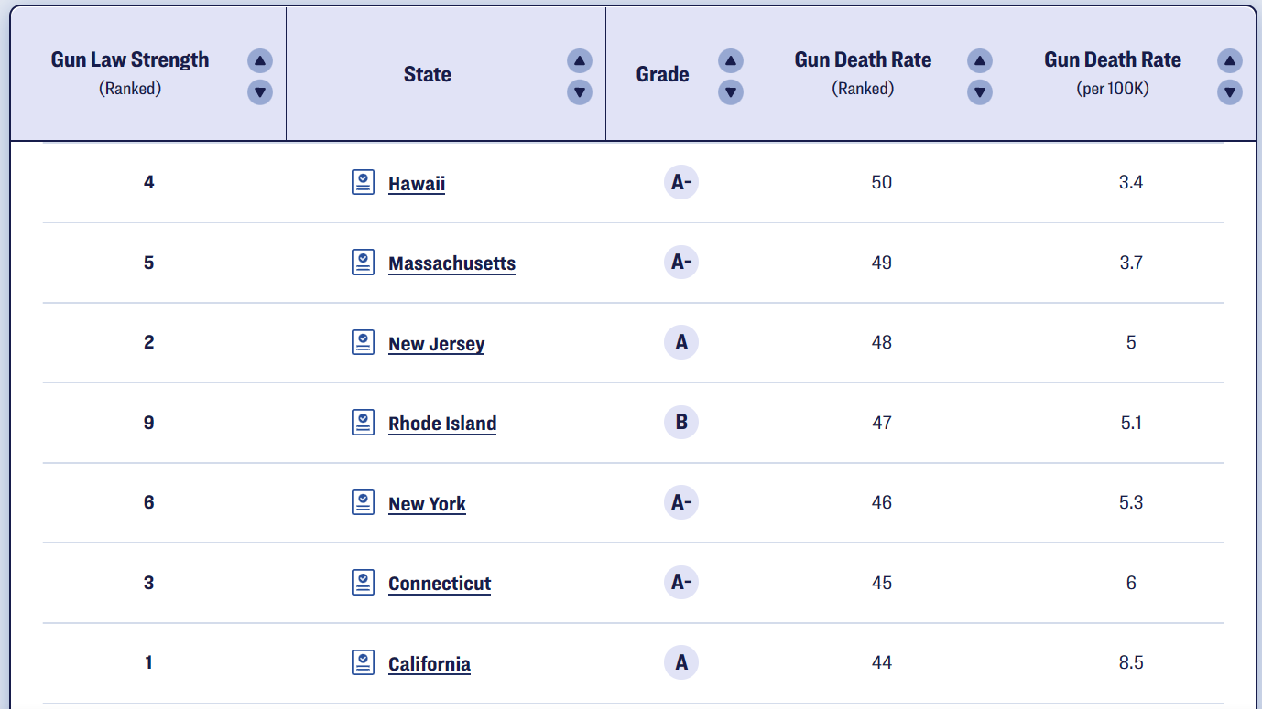
States with stricter gun control policies have lower rates of gunshot deaths
States with lowest gun death rates ranked higher in gun law strength
From Giffords data 2021

Slide 8
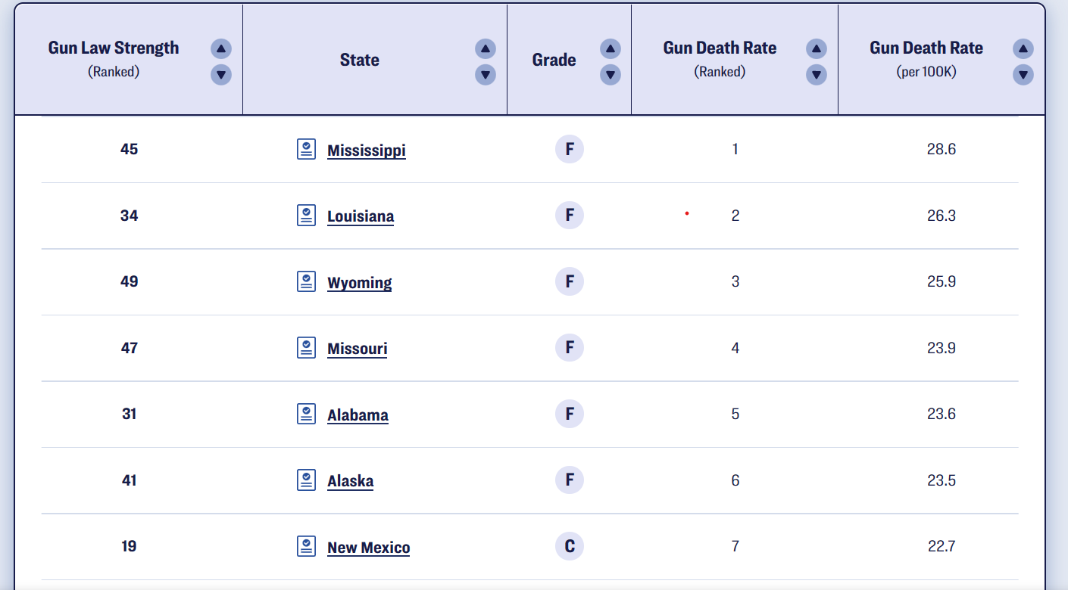
States with more lenient gun control policies have higher rates of gunshot deaths
States with highest gun death rates ranked lower in gun law strength
From Giffords data 2021

Slide 9
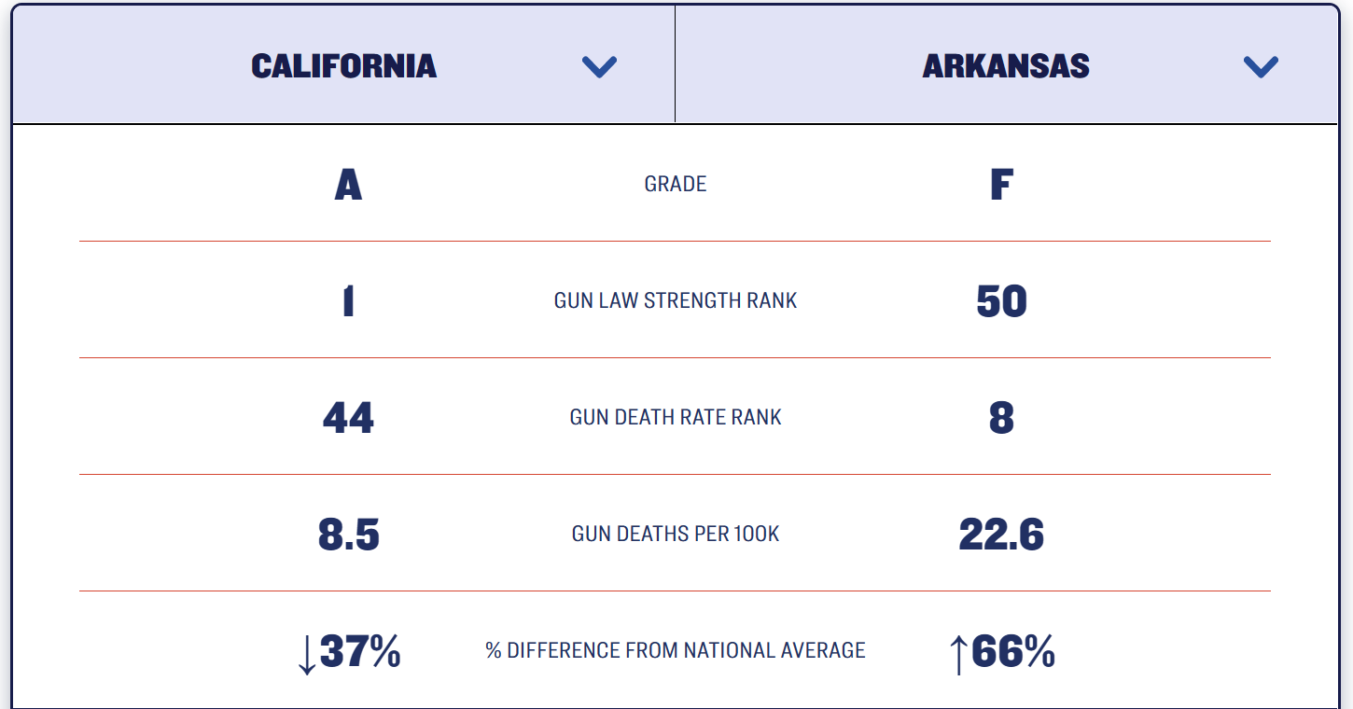
Special Cases
Compare Arkansas, the state with the weakest gun control laws, and California, the state with the strongest gun control laws, California is one-third the size of Arkansas in terms of gun deaths per 100k.
Gun law strength and gun deaths comparison between California and Arkansas
From Giffords data 2021

Slide 10
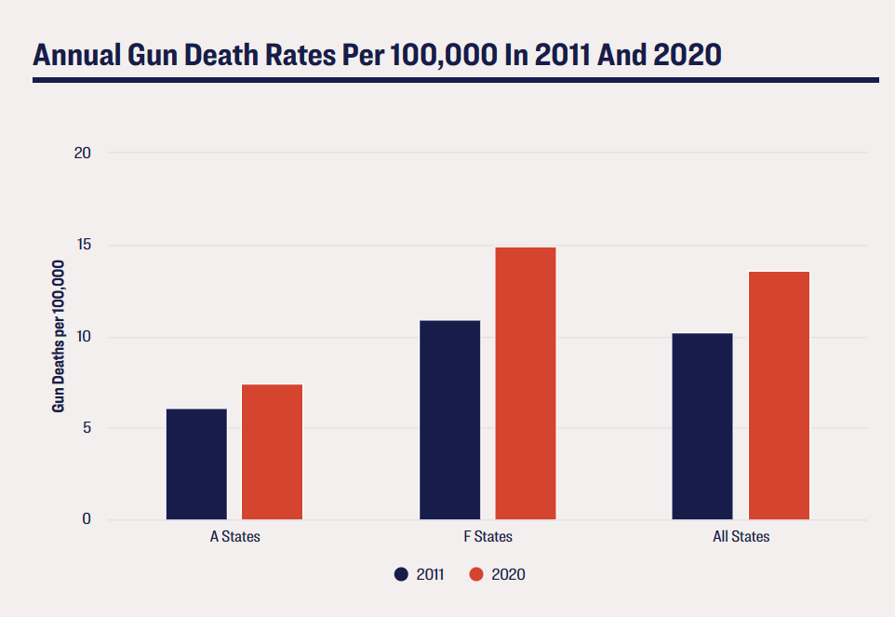
Surges in gun deaths
Over the last decade, gun violence has jumped over 22% across the country. States with the weakest gun laws have been hit hardest by rising violence: from 2011 to 2020, gun death rates rose by a staggering 37% in F states. A states saw a smaller increase over this period, one roughly half the size of F states.
Trend in gun death rates
From Giffords data 2021

Slide 11
Is my data to be trusted?
My data is to be trusted because my sources of the data –BBC News and Giffords are reputable sources of information. Giffords is a nonprofit organization founded by former Congresswoman Gabby Giffords that advocates for gun safety and gun violence prevention.
Also, both source use a wide range of data(world-wide or country-wide), which provides sufficient sample size to analyze.
Both BBC News and Giffords take steps to verify the accuracy of their data before publishing it. This may include fact-checking with multiple sources, consulting with experts in their field, etc.

Slide 12
Is there cherry-picking present? May we fooled by data?
In my data, all the sources are non-partisan.
As both Giffords and BBC News have a reputation for accuracy and impartiality, based on their transparent data collecting and analysis methods, I believe my data is unbiased.
However, it is still possible there are some cherry-picking in my data as the founder and employees of Giffords are mostly promoting gun control. Therefore, it is still possible their expert can select the data with respect to forwarding gun control laws.

Slide 13
Summary
Guns are gradually spreading in the United States due to the epidemic. Gun deaths are rising every year.
Based on the data, we can see that gun control policies have had a positive impact on alleviating the gun problem.
Therefore, in order to slow down the rise of gun deaths or reduce the number of gun deaths, the government should introduce more firearms control mechanisms.

Slide 14

Thank you!

Slide 15
References
BBC News. (2023, January 24). Gun violence in US and what the statistics tell us. https://www.bbc.com/news/world-us-canada-41488081
Giffords: Courage to Fight Gun Violence. (2022, September 21). 2021 Annual Scorecard | Giffords. Giffords. https://giffords.org/lawcenter/resources/scorecard/#how-does-your-state-compare

